Slide 1

Alternative World
Web Site for Theme Park Proposal

Slide 2









Proposal
Outline
Theme Park
Site Map
Purpose
Wireframes
Target
Audience
Team Work
Reasons
Market
Analysis

Slide 3
Purpose
Theme Park Operators benefits from having a Web Site
To gain higher reputation - The Website will provide the information that people will be searching and giving the continuous
To reach customers in every part of world
To be always accessible - A Website is open 24 hours a day, 365 days per year
To target a wider audience - Websites are accessible from anywhere in the world provided that there is an internet connection
To Support and keep customer informed with FAQ and contact us
To enhance the ticket and merchandise sales

Slide 4
Target Audience The People who might look
Children
Kids
Parents

Slide 5
Why looking at the Web Site
To discover the Park
To know about special events and attractions
To book tickets in advance
To ask for help

Slide 6
Other Theme Parks
The theme parks reviewed for our market analysis are
https://www.ferrariworldabudhabi.com
https://www.wbworldabudhabi.com
https://disneyworld.disney.go.com/
https://www.europapark.de/en
https://www.luneurpark.it/

Slide 7
Other Theme Parks - 2
Ferrari World and Warner Bros seems to be developed from the same web framework.
The type of information identified on those two theme parks:
Plan your visit
Explore
Tickets
Offers
Events
Group Booking
Internationalization (Language Selection)
Account Creation/Login

Slide 8
Other Theme Parks - 3
The Disney World theme park in Orlando is organised to provide the following information
Parks and Tickets
Places to Stay
Things to Do
Shop
Help and Rules
Cart
Personal planning experience

Slide 9
Other Theme Parks - 4
The Europa Park is organised to provide the following information
Attractions
Shows and Events
Accommodation
Food and Drink
Tickets and Gift Cards
Info

Slide 10
Other Theme Parks - 5
The LunEur Park is organised to provide the following information
Timetable
Events
Maps
Tickets

Slide 11
Other Them Parks - 6
The top list is taken by the Disney World Theme Park website. The graphics and the overall presentation are very professional and all the aspects of the web site are very well considered.
The customer is immediately able to book an entire holiday with ease and ready to explore every corner of the theme park. All this elements, however, contribute to a more complex and crowded set of information.
The Ferrari world and the Warner Bros are very good in their simplicity and allow the customer to easily plan their visit.
The LunEur Park is the example with more not well implemented features, too many colours in the presentation and internationalization is totally missing making it very difficult to be usable.

Slide 12
Alternative Worlds Theme Park
The theme of the park is “alternative worlds”. A place where you can experience the future that you decide.
Future Visions. 5 cities to be experienced in Virtual and Augmented Reality
The Soft World. An area dedicated to children where everything is soft
The Plaza. The place to relax, find food, buy the merchandise, withdraw money, Customer Centre, Medical help
The Flying Machine. Futuristic and Fast sky coaster (https://en.wikipedia.org/wiki/Skycoaster)
Theatre of the Future. An interactive theatre made by real living people and hologram
The web site is responsive and adaptive, developed with HTML 5 semantic web syntax.

Slide 13

Site Map
The site map of the Alternative Worlds Web Site is organised with a total of four pages. The book tickets page can be removed to adhere to the requested standard of a total of three pages.

Slide 14
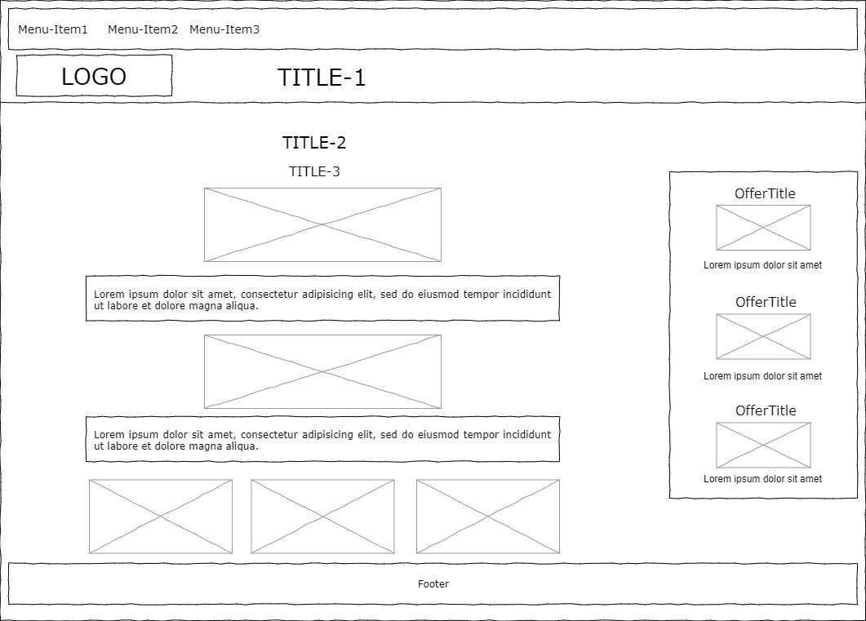
Wireframes – Desktop – Index

Slide 15
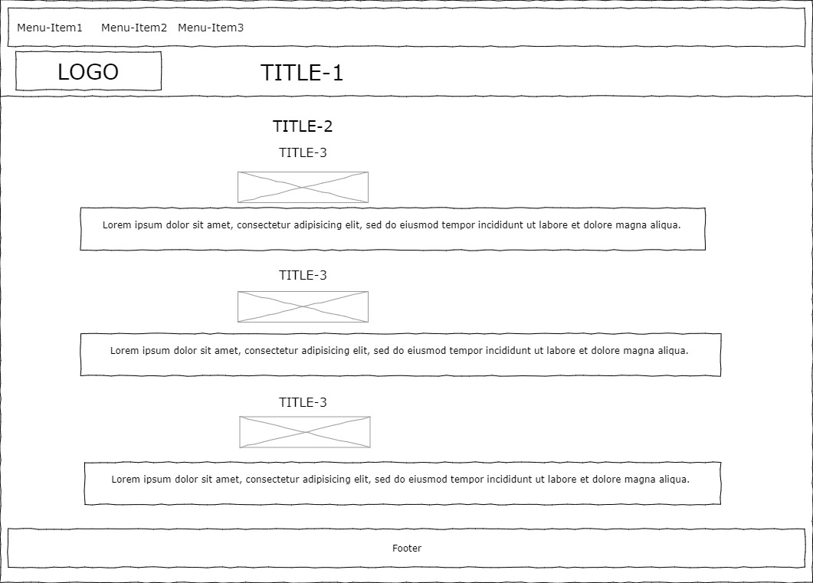
Wireframes – Desktop – Attractions

Slide 16
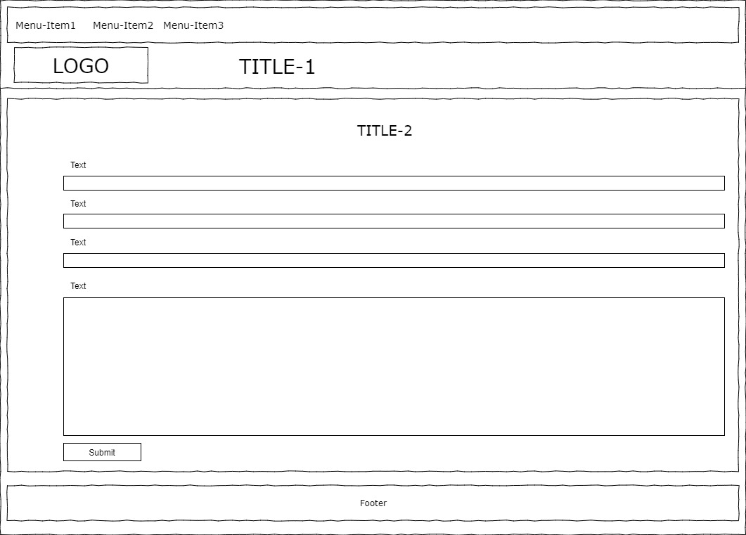
Wireframes – Desktop – Contact Us

Slide 17
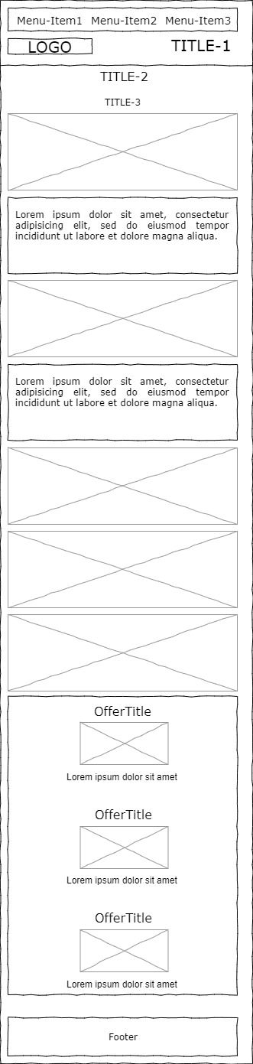
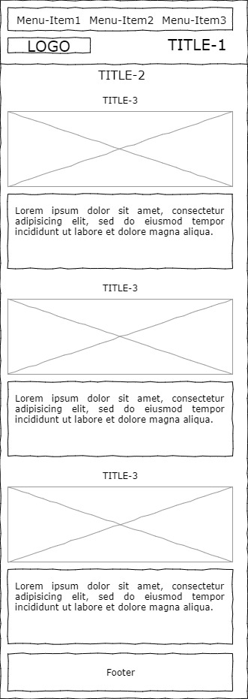
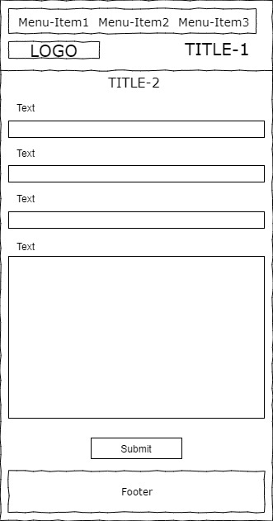
Wireframes – Mobile

